Slide 1


BEACH RESORT MANAGEMENT SYSTEM

Slide 2
PROJECT REPORT ON BEACH RESORT MANAGEMENT SYSTEM
J.V.M’s MEHTA DEGREE COLLEGE
MUMBAI UNIVERSITY
2020 – 2021
SUBMITTED BY
MEGHNA SHANTIPADA MIDYA
1818
T.Y.Bsc.CS

Slide 3



University of Mumbai
JNAN VIKAS MANDAL’s
MOHANLAL RAICHAND MEHTA COLLEGE OF COMMERCE
DIWALI MAA COLLEGE OF SCIENCE
AMRITLAL RAICHAND MEHTA COLLEGE OF ARTS
Dr. R.T. DOSHI COLLEGE OF COMPUTER SCIENCE
CERTIFICATE
This is to certify that Miss. MEGHNA SHANTIPADA MIDYA, student of T.Y.B.Sc.CS of J.V.M’s Mehta Degree College has successfully completed the Project work titled “BEACH RESORT MANAGEMENT SYSTEM” in partial fulfillment in this educational year of University of Mumbai.
This Project is the record of authentic work carried out during the academic year 2020-2021. It is further certified that she has completed all required phases of the Project.
Date of Submission: ________________ Exam Seat No: ________________
__________________ __________________
Mrs. Sarita Sarang Mrs. Janhavi Kshirsagar
(Internal Guide) (Head of Department)
__________________
External Examiner

Slide 4

INDEX
01
Abstract
02
Introduction
03
Preliminary Investigation
04
Proposed System
05
Hardware & Software
06
Advantages & Disadvantages
07
Software Process Model
08
Data Flow Diagram
09
Database Design
10
Screen Layout
11
Conclusion
12
13
References
Scope Of Future Enhancement

Slide 5

ABSTRACT
Beach Resorts Management System project is implemented in the ASP.NET Web Application (.NET Framework) platform using C#, HTML and CSS as web technologies and SQL Server as a back end database. The beach resort management system project’s main idea is to develop an portal for atomization of the resort booking system and to create a scope for visiting tourists from different geographic locations. This application will help to improve services for tourists and also improve the revenue source for resorts management.

Slide 6
INTRODUCTION
The system aims at the maintenance and management of the different activities and accommodations that are available in the Beach Resort.
It mainly takes care of the resort management at the core area of giving information and collecting data.
The system provides information regarding the different resorts that are available and the activities available near them.
Beach Resort Management System involves the management of multitude of activities such as studying destination, making travel arrangements, providing accommodation, providing activity ideas and booking activities. It also involves marketing efforts to attract tourists to travel to a particular destination.
The Beach Resort Management System is a stand-alone based application to maintain a centralized repository of all related information of the resort and traveler's.
The purpose is to design a system using which one can perform all operations related to travelling and sight-seeing.

Slide 7

PRELIMINARY INVESTIGATION
LIMITATION OF PRESENT SYSTEM
The current manual system uses paperwork and direct human language communication to manage the resort. This delays information transmission in the resort.
Booking is done through phone calls or through visiting the resort booking office. The guest’s personal details such as Name, Address, Nationality and Duration of stay, are inserted during check-in. The booking office orders for preparation of the guest’s room before his/ her check-in-time. The documents are transferred manually.
All the existing system is traditional and lack in use of technology, therefore the process is very time consuming and lengthy as paper work is there. This was creating problem to maintain data record at the end like profit and loss, total expenses, etc.

Slide 8
PRELIMINARY INVESTIGATION
PROBLEMS IN THE MANUAL SYSTEM
Difficulty in location of guest files: Due to the large number of guest’s files, location of guest files during checking in, updating of daily expenditures, receipt generation and checking out is extremely difficult for the resort employees.
Large storage space: The physical files occupy too much space of about two rooms full of storage cabinets. This occupies the resort’s space that could have otherwise been used for income generation by the resort.
Human errors: Many errors enabled by the human due to tedious computations required during data processing.
Poorly generated records: Poorly generated records encourage omission of some important data by the employees. Such data as the guest’s luggage is omitted.
Poor communication: Due to poor communication between the departments, guests are often served with services they didn’t order.
Difficulty in data analysis: The accountants usually found it difficult to analyze the guest’s data during generation of expenditure bills due to missing of some records.
ADVANTAGES OF THE MANUAL SYSTEM
Employees don’t need special computer skills to run the manual system
Relatively low running costs as the system requires no electricity, internet services as the computerized system would.
DISADVANTAGES OF THE MANUAL SYSTEM
Guest files can easily get lost or mix up with other guest file documents.
Unnecessary duplication of data.

Slide 9
PROPOSED SYSTEM
Resort Management System is an integrated software developed for resort management. The main aim of this project is to help the resort to manage their customers accommodation and analyze their requirements. It makes all operations of the resort management easy and accurate.
Objectives of proposed system are:
To enable online booking.
To enable automated data entry methods.
Ensure efficient and reliable communication within the resort.
Avoid data entry errors by use of input masks.
Enable easy authorized modification of data.
Enable fast and easy retrieval of guest records and data for fast reference activities.
Different modules have been incorporated in this project to handle different parts and sectors of the resort management field, such as:
Index/Home Module
About Us Module
Rooms Module
Activity Module
Restaurant Module
Contact Module

Slide 10
HARDWARE
Processor | Intel Core i5 CPU 1.00 GHz or more
RAM | 8.00 GB or more
HardDisk | 256SSD or more
Monitor | 15” CRT or LCD Monitor
Keyboard | Normal or Multimedia
Mouse | Compatible Mouse
SOFTWARE
Front End | ASP.Net
Software Required | Microsoft Visual Studio
Back End | SQL Server
Operating System | Windows 10

Slide 11
ADVANTAGES
The system enables easy and fast access to the guest files.
The system provides better data management facilities.
The system enable online booking of guests into the resort hence international guests can easily book into the hotel.
Easy update of the guest records.
High customer service standards attract more guests to the resort.
Reduction of data entry and processing errors. Greatly reduce paper use at the hotel.
This system helps in removing the bottleneck of phone booking systems.
This system is a modern approach to book your tour.
DISADVANTAGES
The hotel will be required to train its employees on how to manage the system hence the hotel output capacity will reduce a bit during this period.
There may be restrictive terms and conditions imposed by online tourism management system such as guest cancellation and automatic room reselling policies.
Requires internet access

Slide 12
SOFTWARE PROCESS MODEL
Requirements Analysis:
A SRS is provided by organization. The aim of Beach Resort Management System is to provide convenient and easy way for customers to book their accommodation and activity.
01
Design
In this phase the modules of the project is designed according to the SRS ( Software Requirement Specification) .
02
_{WATERFALL} _{MODEL}
Development
Development of the modules are done by the developers by following the provided design and SRS.
03
Testing
The modules are tested individually and then all modules are integrated together to test the whole system. In this phase tester check the system required is as per SRS.
04
05
Maintenance
This phase comes in seen when the system is delivered to the organization. The maintenance of system is done in this phase.

Slide 13
DATA FLOW DIAGRAM
DATABASE
DATABASE
CUSTOMER
SYSTEM
SITE MASTER
INDEX/ HOME
ABOUT US
ROOMS
CONTACT
ACTIVITY
RESTAURANT

Slide 14
DATA FLOW DIAGRAM
HOME/LOGIN
INDEX/HOME (HOTEL)
ALIBAUG
DIU
DAMAN
GOA
MUMBAI
ROOMS
ROOMS
ROOMS
ROOMS
MALVAN
ROOMS
ROOMS
CONTACT
ROOMS
ROOMS
EXPLORE
BOOKING

Slide 15
DATA FLOW DIAGRAM
ACTIVITY
ACTIVITY
SNORKE-LING
HOT AIR BALLOON
PARASAI-LING
FLY BOARDING
SCUBA DIVING
ACTIVITY BOOKING
ACTIVITY BOOKING
ACTIVITY BOOKING
ACTIVITY BOOKING
WIND SURFING
ACTIVITY BOOKING
ACTIVITY BOOKING
COMBO PACK
ACTIVITY BOOKING
CONTACT
CONTACT
FEEDBACK

Slide 16
DATABASE DESIGN
dbo.FeedbackBeachResort
Column Name | Data Type (Length)
FeedbackId | int IDENTITY(1,1)
FeedbackName | varchar(50)
FeedbackSurname | varchar(50)
FeedbackContactNo | varchar(50)
FeedbackEmailId | varchar(50)
FeedbackMessage | varchar(50)
FeedbackHotel | varchar(50)
FeedbackRoom | varchar(50)
FeedbackActivity | varchar(50)
FeedbackRestaurant | varchar(50)
FeedbackOverall | varchar(50)
dbo.ContactBeachResort
Column Name | Data Type (Length)
ContactId | int IDENTITY(1,1)
ContactName | varchar(50)
ContactContactNo | varchar(50)
ContactEmailId | varchar(50)
ContactMessage | varchar(MAX)

Slide 17
dbo.BookingBeachResort
Column Name | Data Type (Length)
BookingId | int IDENTITY(1,1)
BookName | varchar(50)
BookSurname | varchar(50)
BookEmailId | varchar(50)
BookContact | varchar(50)
BookAddress | varchar(50)
BookCity | varchar(50)
BookState | varchar(50)
BookCountry | varchar(50)
BookPincode | varchar(50)
BookInDate | varchar(50)
BookInTime | varchar(50)
BookOutDate | varchar(50)
BookOutTime | varchar(50)
BookDestination | varchar(50)
BookRoomType | varchar(50)
BookAdults | varchar(50)
BookChilds | varchar(50)
BookRooms | varchar(50)
dbo.ActivityBeachResort
Column Name | Data Type (Length)
ActivityId | int IDENTITY(1,1)
ActName | varchar(50)
ActEmailId | varchar(50)
ActContact | varchar(50)
ActAddress | varchar(50)
ActCity | varchar(50)
ActState | varchar(50)
ActCountry | varchar(50)
ActPincode | varchar(50)
ActChooseDate | varchar(50)
ActChooseTime | varchar(50)
ActChooseActivity | varchar(50)
ActParticipants | varchar(50)

Slide 18
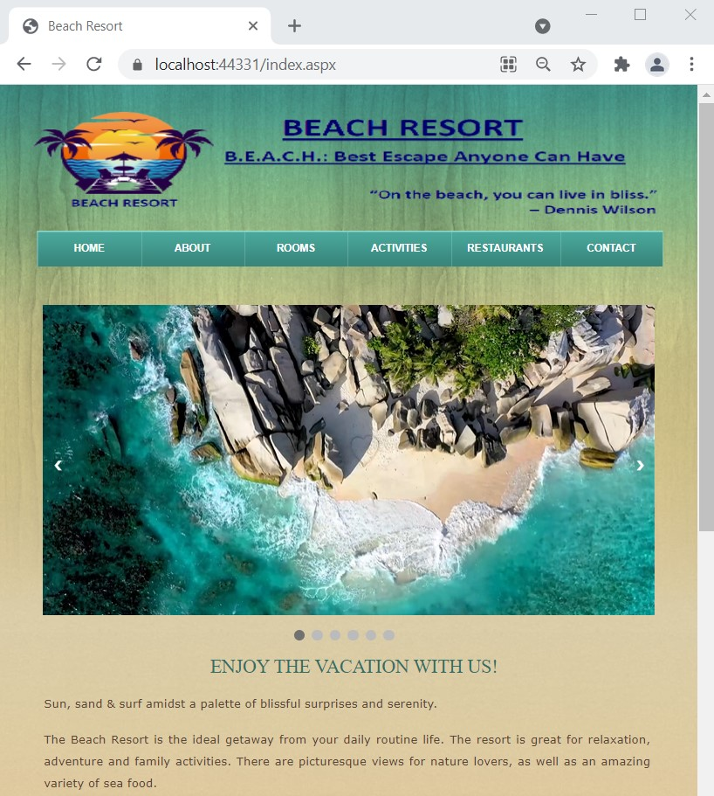
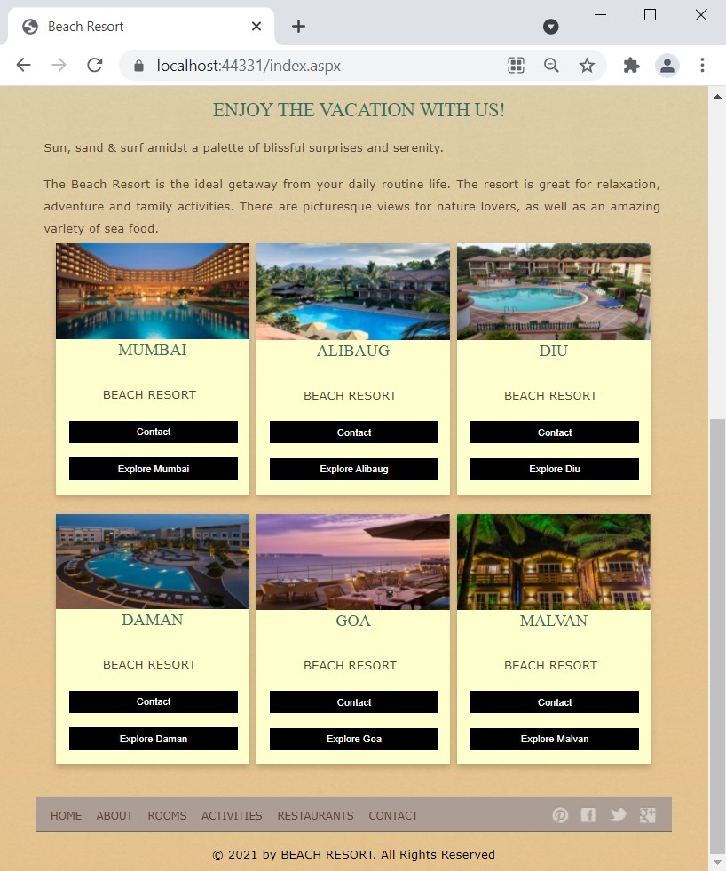

SCREEN LAYOUT
index.aspx
Home page:
It is the introduction as well as first page of Beach Resort.
It gives information about various resorts at available at various destination. By clicking on explore button it will direct you to the information pages of the respective resort. By clicking on contact button it will move to our contact page.
Site Master:
It contains logo, header and footer of the project design.
Header : It contain total 6 navigation tabs. Activity tab further contains 7 more navigation tabs.
Footer: It contain 6 reference tabs that are Home, About, Rooms, Activities, Restaurants and
Contact. In the last there are social media icons that links the customer’s with our social media.

Slide 19
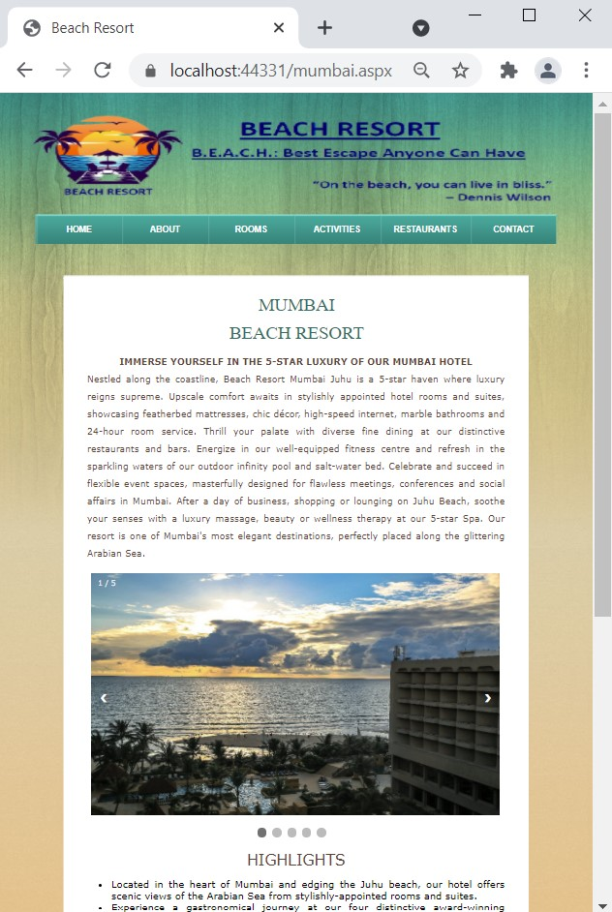
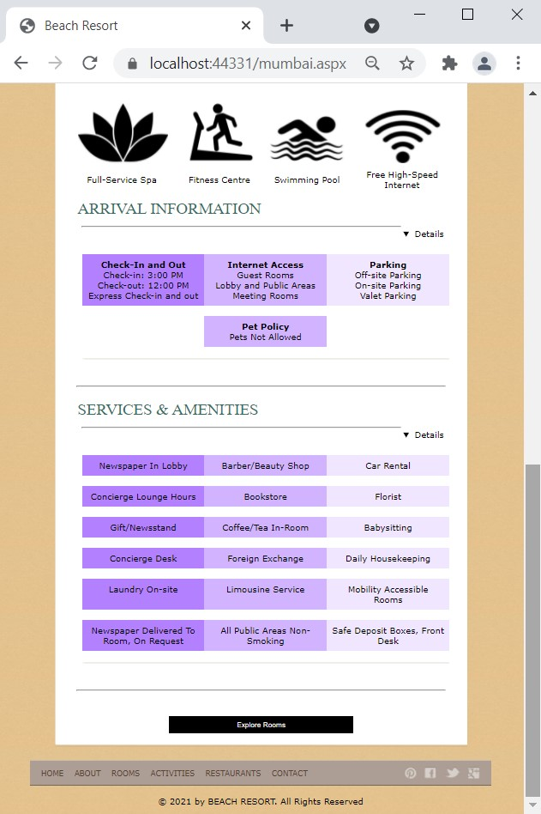
mumbai.aspx
This page gives more information about resort in Mumbai.

Slide 20
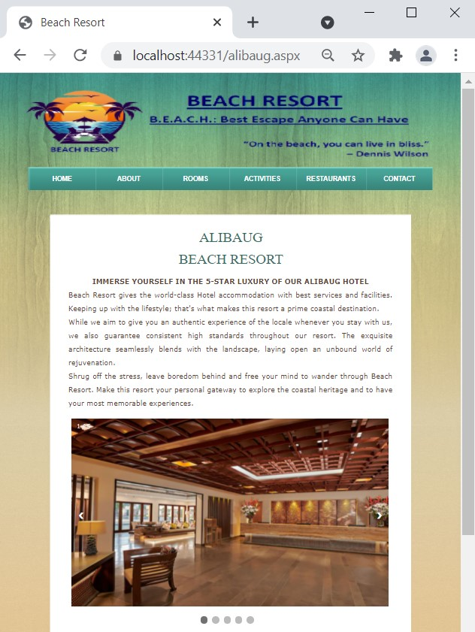
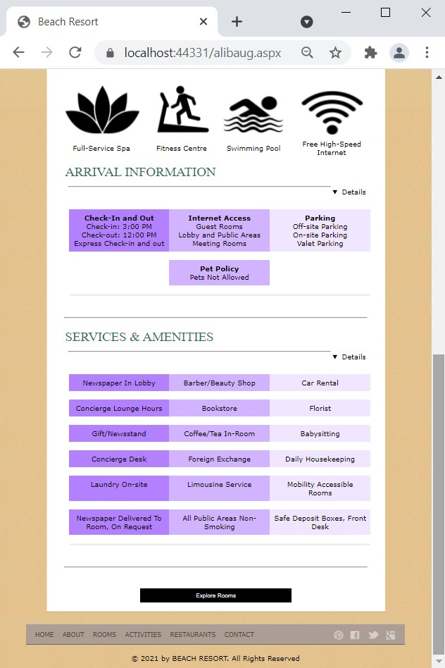
alibaug.aspx
This page gives more information about resort in Alibaug.

Slide 21
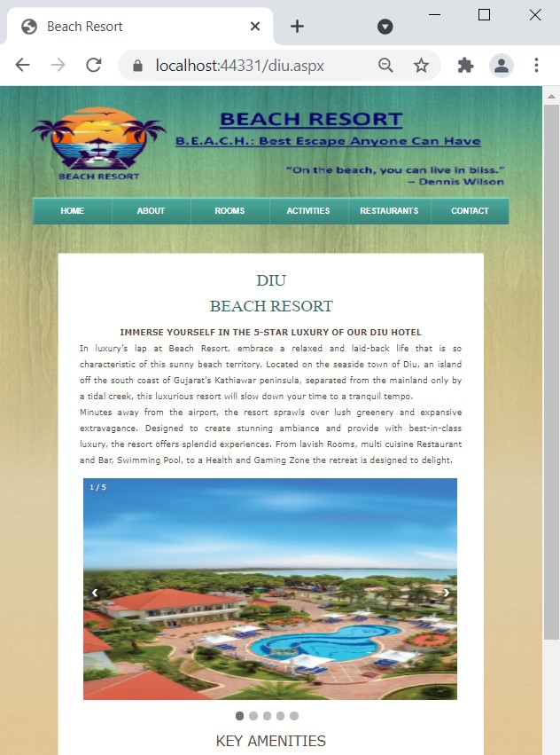
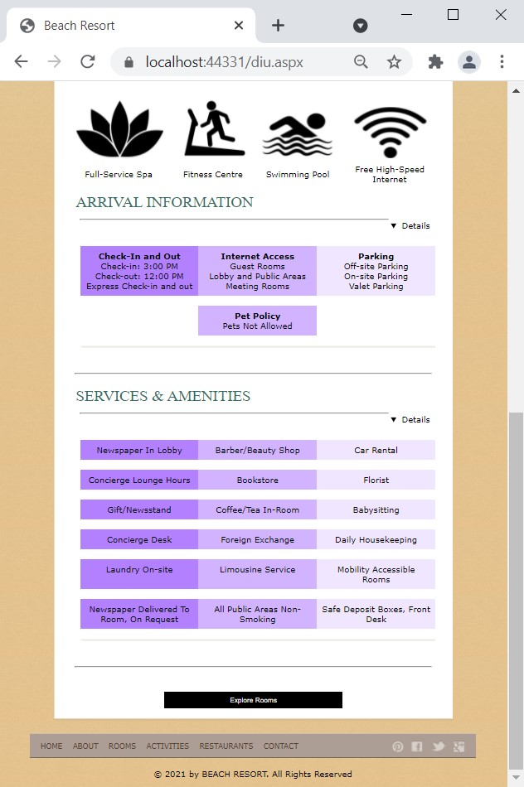
diu.aspx
This page gives more information about resort in Diu.

Slide 22
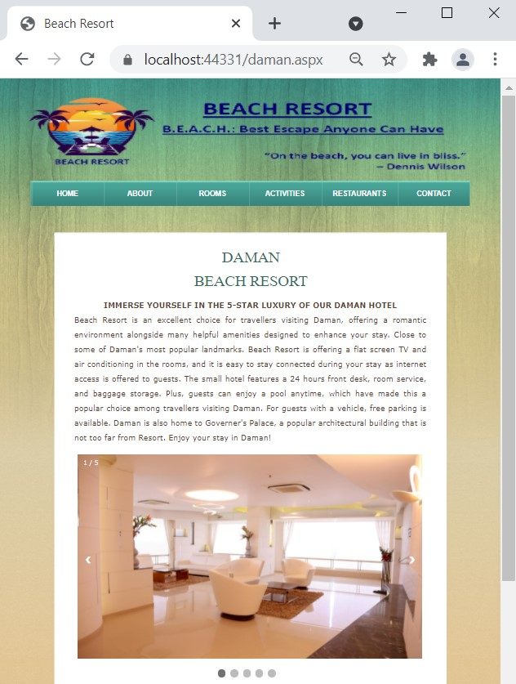
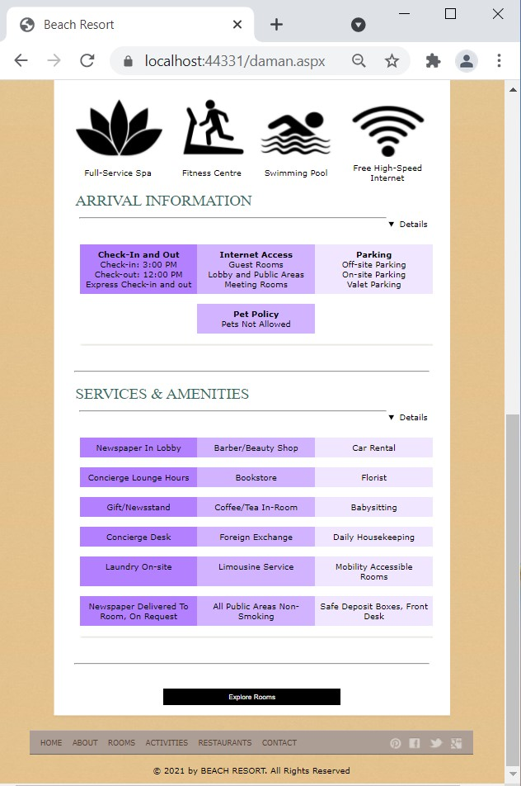
daman.aspx
This page gives more information about resort in Daman.

Slide 23
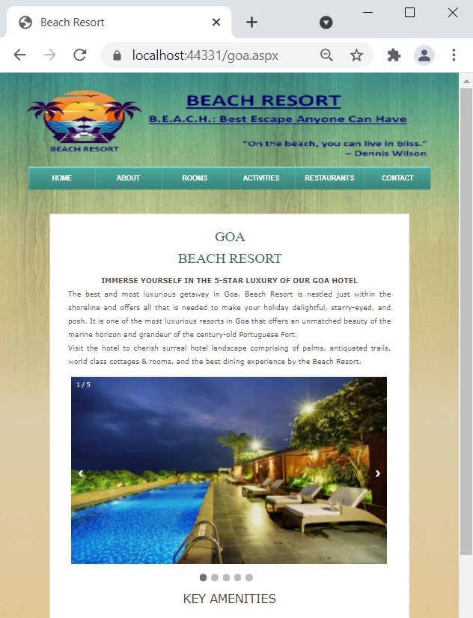

goa.aspx
This page gives more information about resort in Goa.

Slide 24
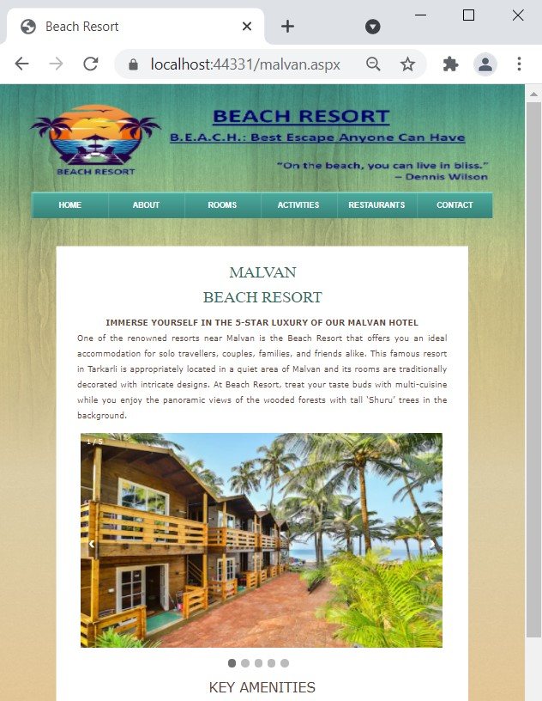

malvan.aspx
This page gives more information about resort in Malvan.

Slide 25
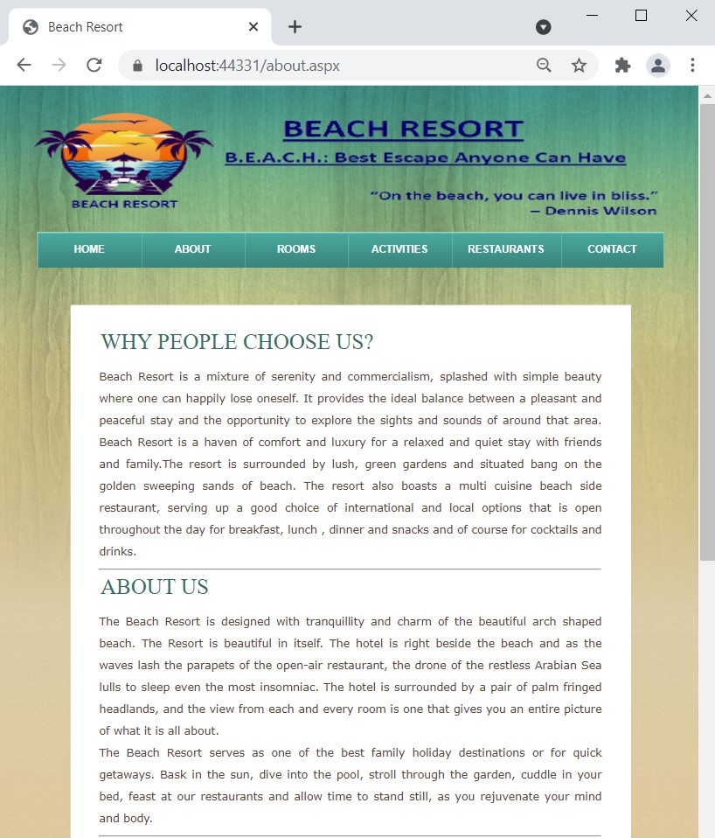
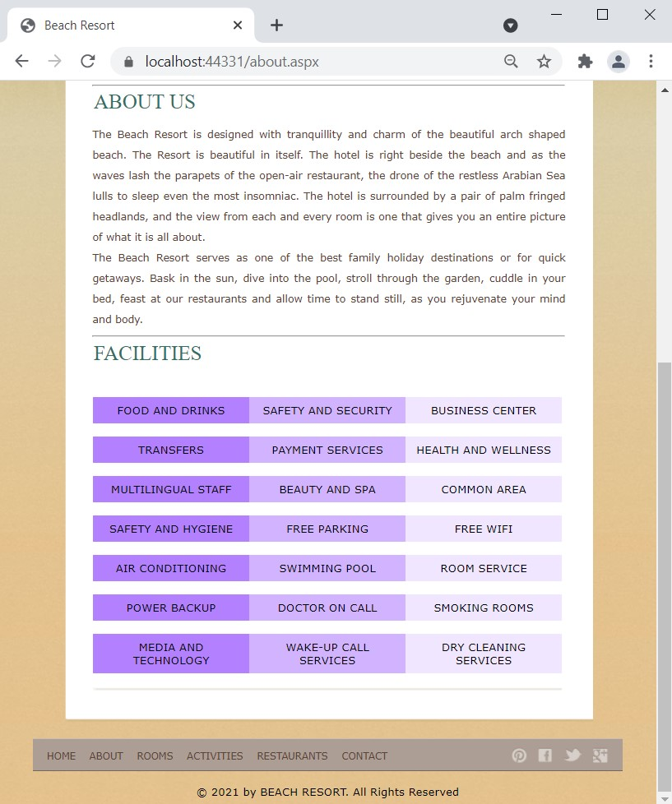
about.aspx
About page:
It is the about page of Beach Resort Management System.
It provides detailed information about facilities the Beach Resort. For example: Food & Drinks, Safety & Security, etc.
It also gives information about the website such as Why People Choose Us? and About Us

Slide 26
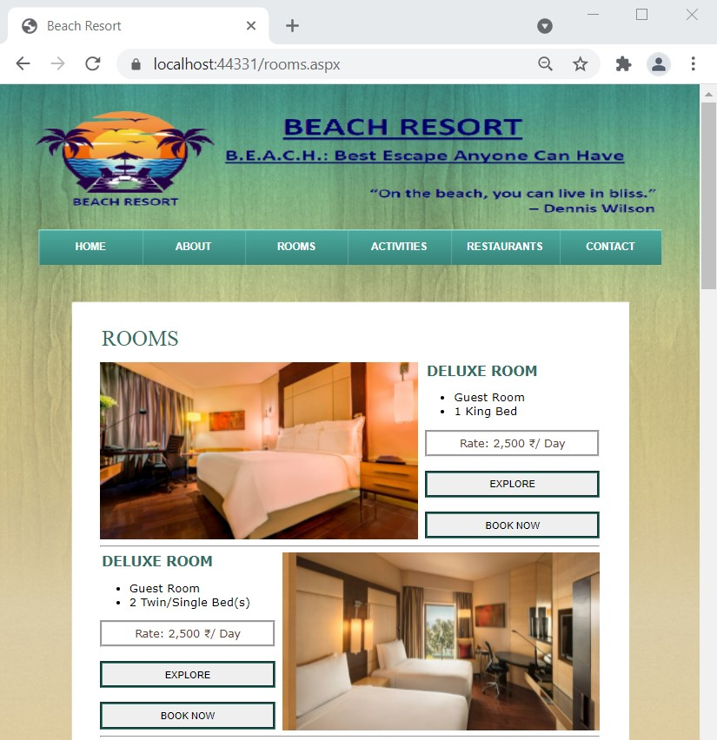
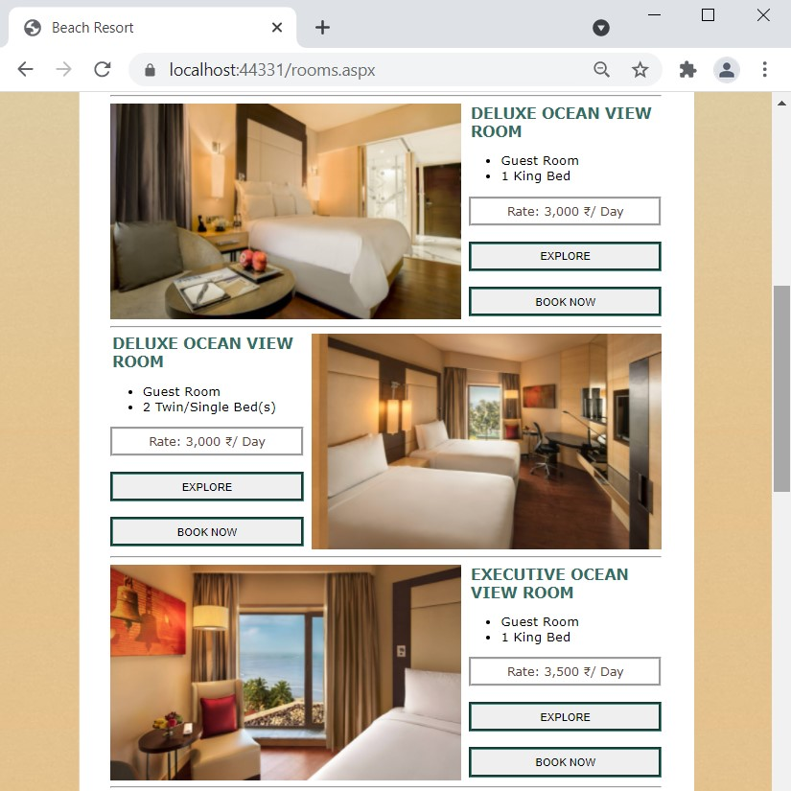
rooms.aspx
Rooms page:
This page provides detailed information and
facilities about the rooms that are available in Beach Resort.
Various types of rooms that are available in beach resort are:
Deluxe Room
Deluxe Ocean View Room
Executive Ocean View Room
Premier Club
Studio Suite
Executive Beach Suite
Grand Ocean Suite
Royal Suite
Presidential Suite
When the user clicks on explore button it directs them to explore page where more information about the room is given, and when the user click on book now button it direct them to booking page.

Slide 27
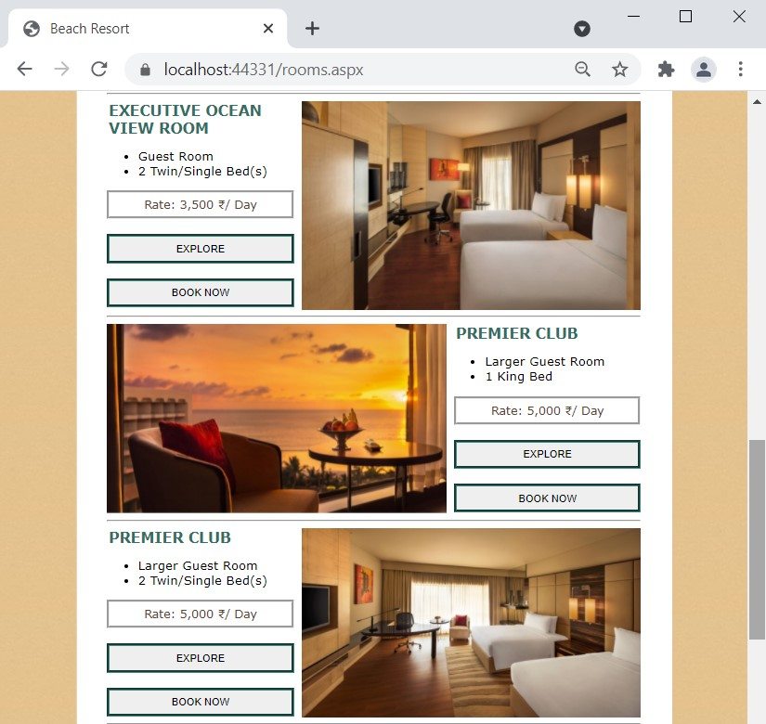
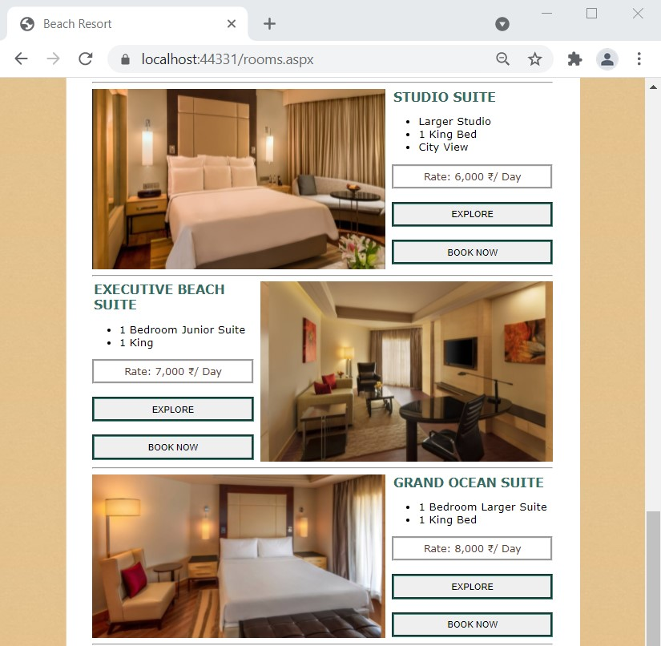
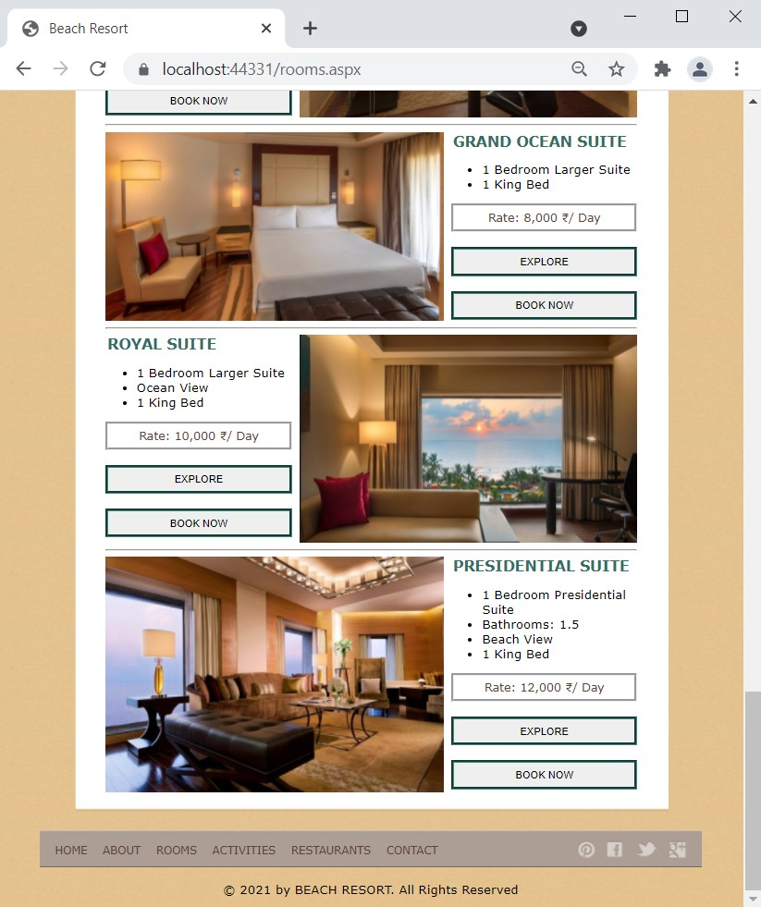

Slide 28
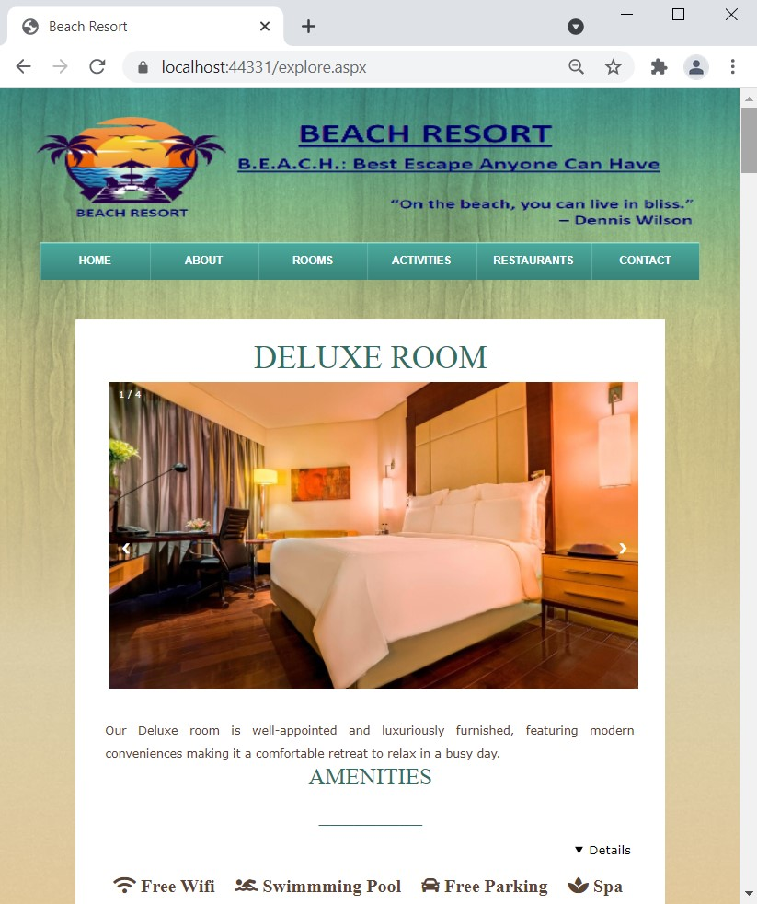
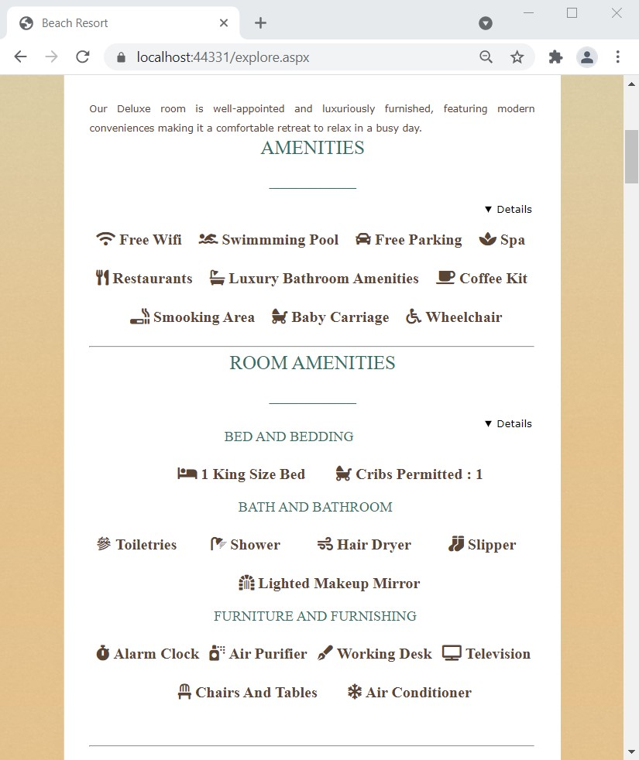
explore.aspx
Explore page:
This page of the website gives a detailed information of the amenities and room amenities that are available in the various rooms of resort.
Every room have a short info about itself in this page.
Various photos of the rooms are available here.
List of Amenities & Services in Beach Resort:
Room Features
Electronic Safe
Mini Bar Chargeable
Tea/Coffee Maker
Wardrobe
Bed & Bath
Bathrobe & Slippers
Hair Dryer
Shaving Mirror
Services
Butler Service (Chargeable)
24 Hour Room & Concierge Service
Express Laundry Service (Chargeable)
Free Wi-Fi
Turn Down Service
Twice-Daily Housekeeping Service With Complimentary
Packaged Water

Slide 29
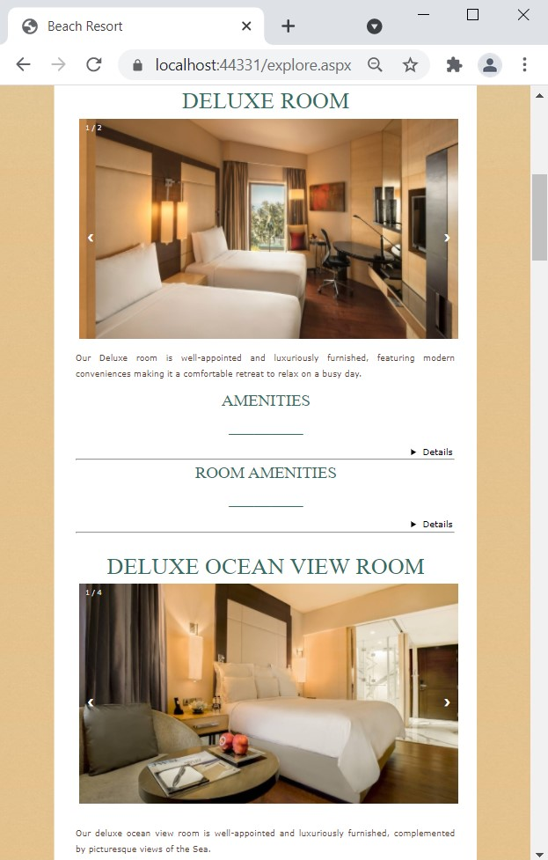
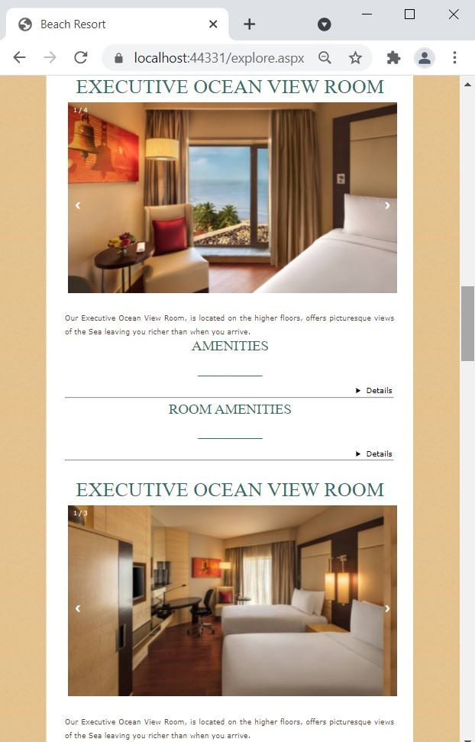
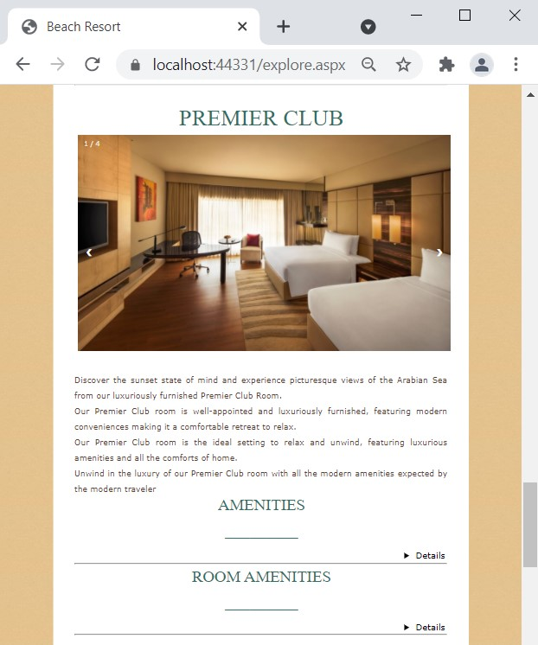
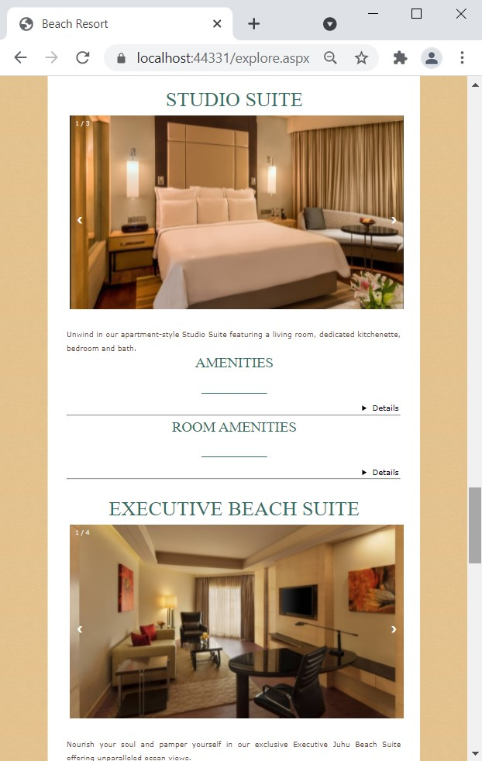
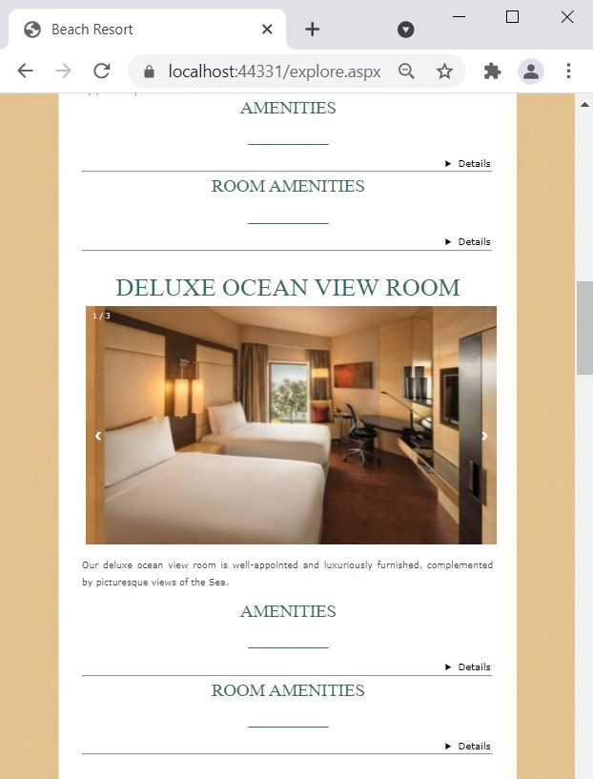
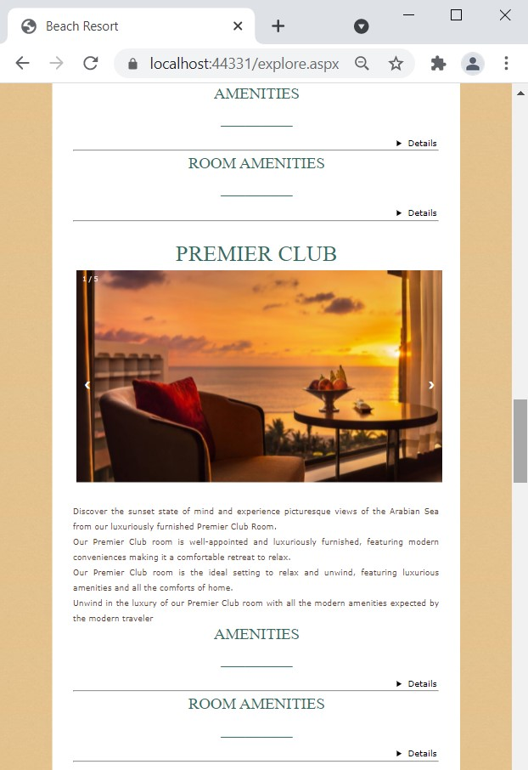

Slide 30
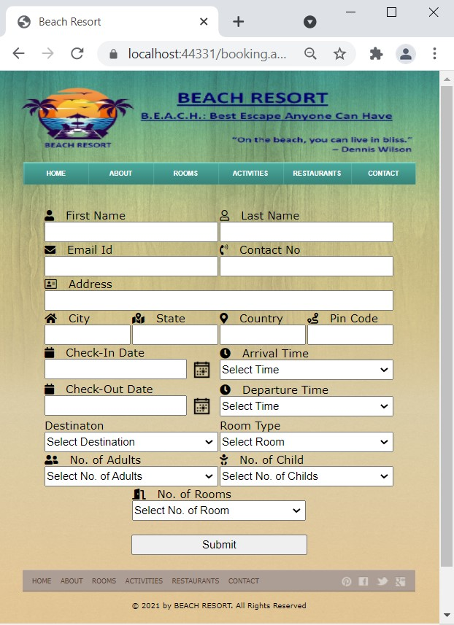
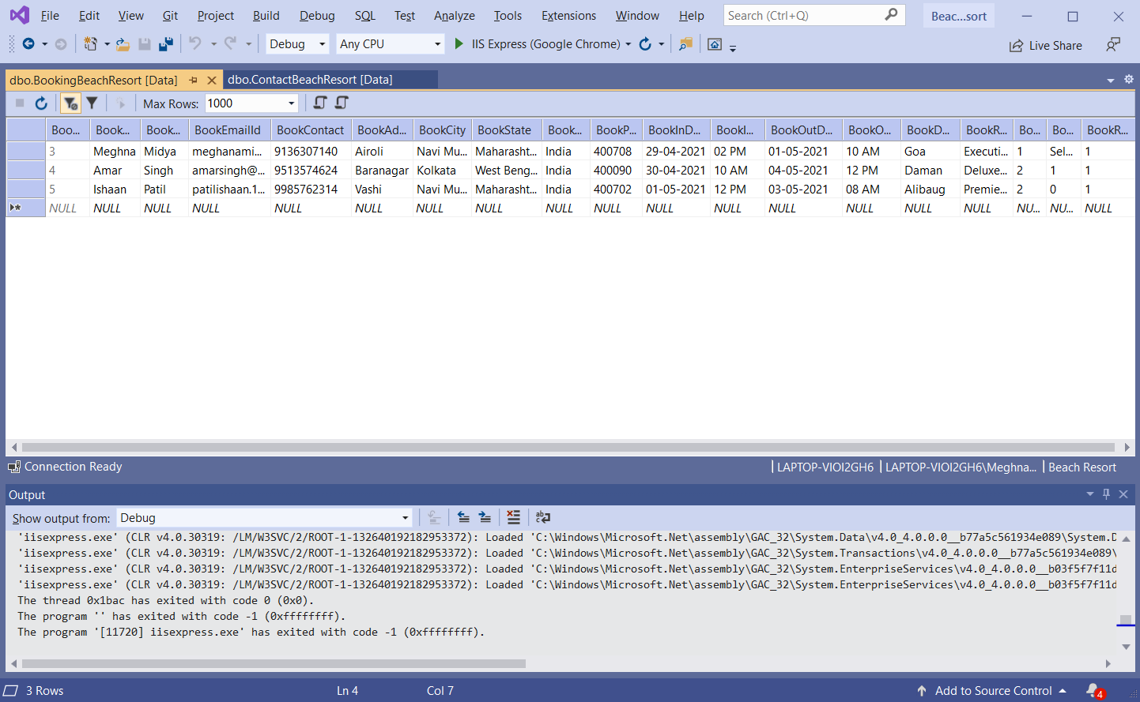
booking.aspx
booking.aspx
This is the booking page for rooms.
This is the booking page for rooms.

Slide 31
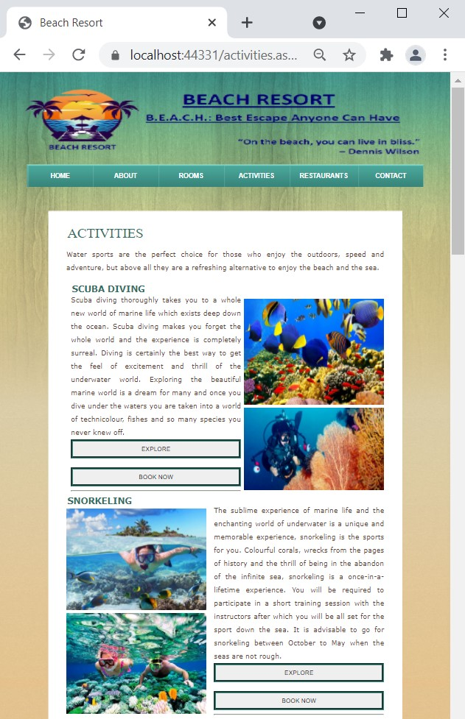
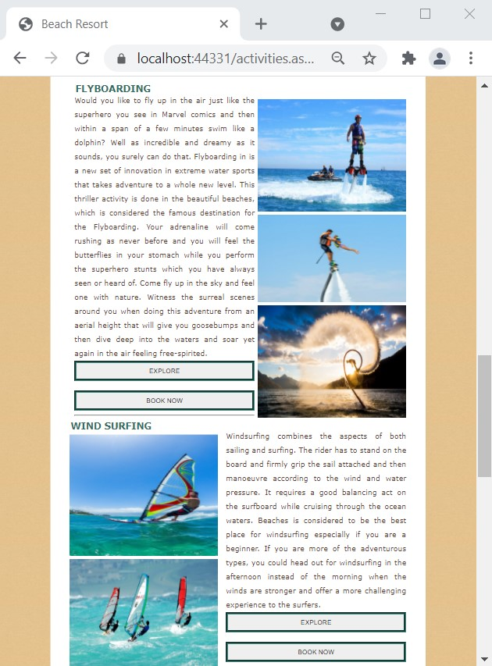
activity.aspx
Activities page:
This page of the site contain detailed information about activities that are conducted in beaches and it's types. Here we have a range of activities for in-house guests.
This page provides each and ever basic details of the activity.
Types of activities available are:
Scuba Diving
Snorkeling
Hot Air Balloon
Parasailing
Fly Boarding
Wind Surfing
Combo Pack

Slide 32
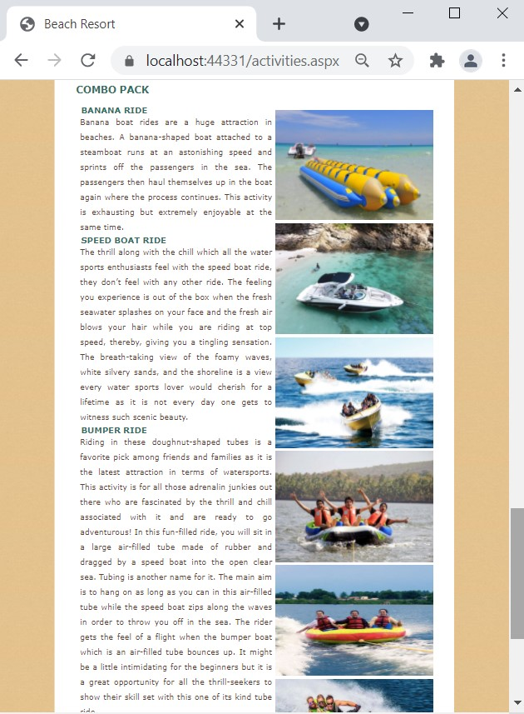
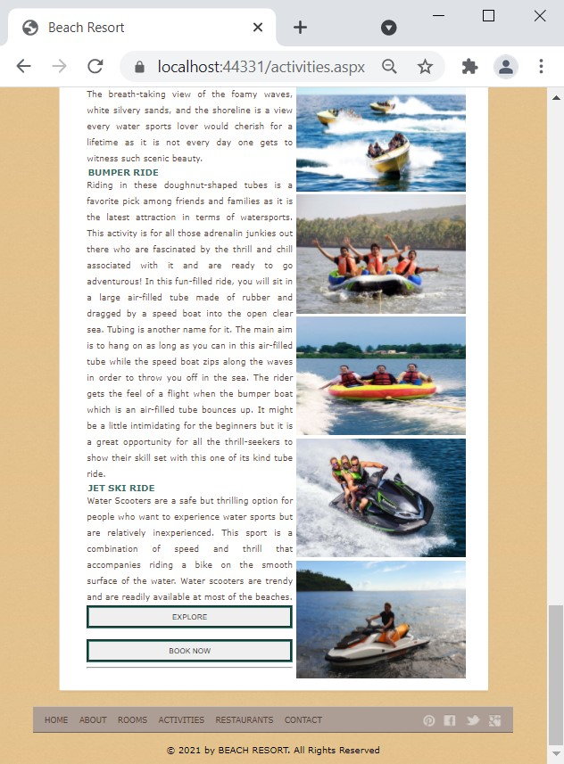

Slide 33
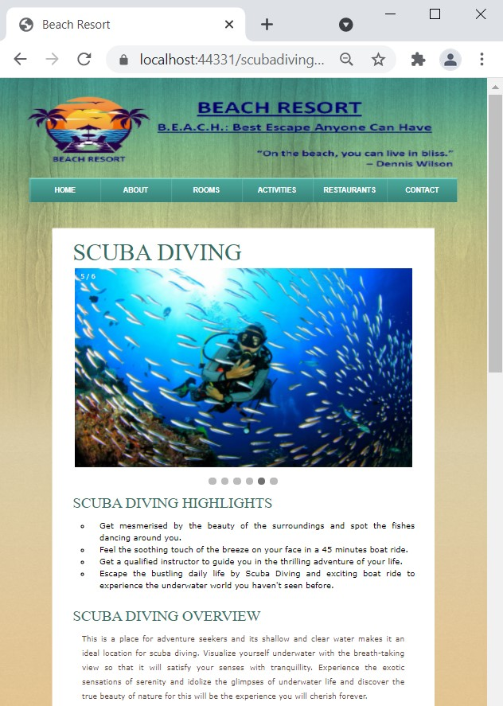
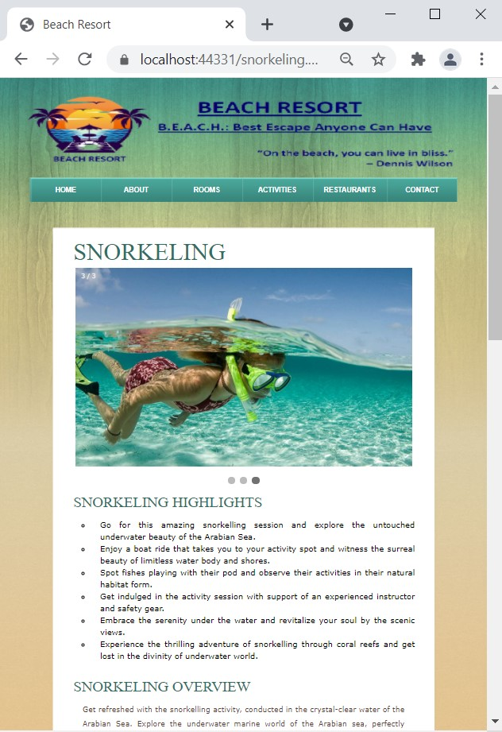
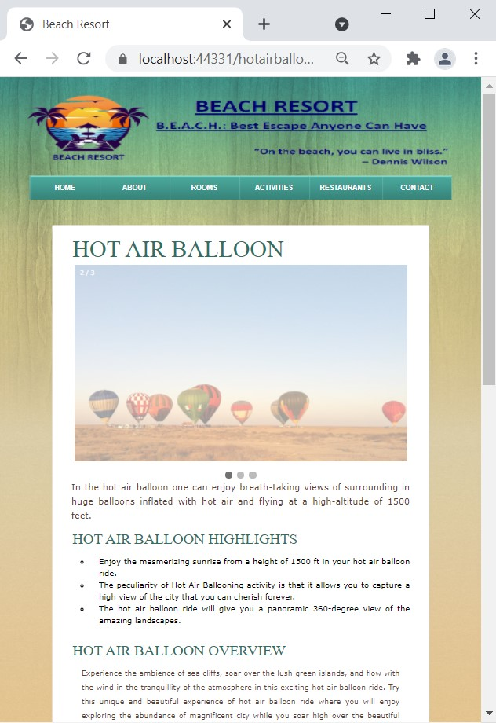
scubadiving.aspx
snorkeling.aspx
hotairballoon.aspx

Slide 34
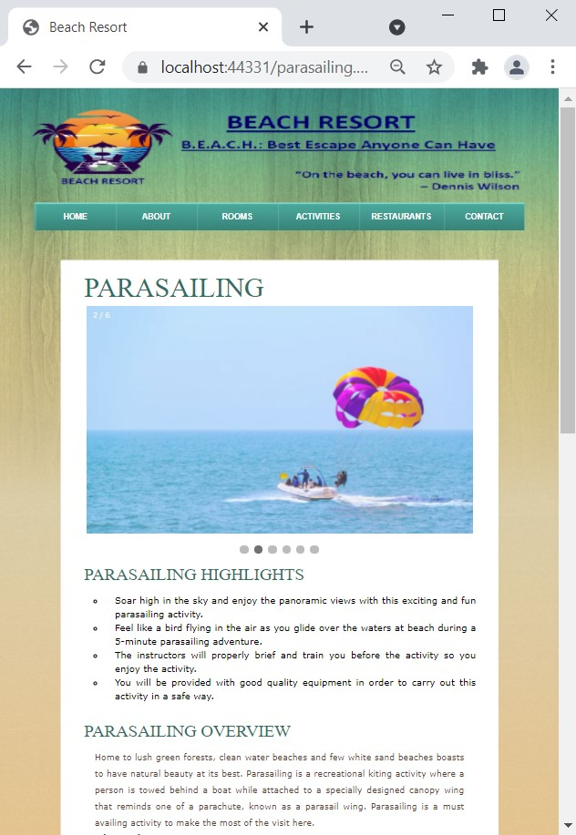
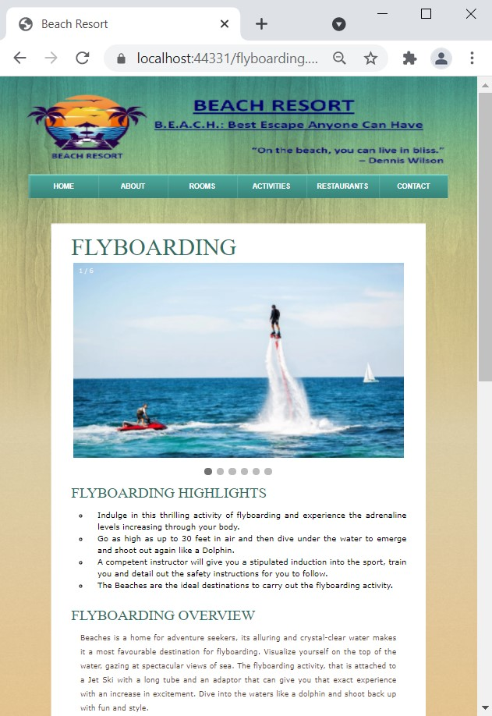
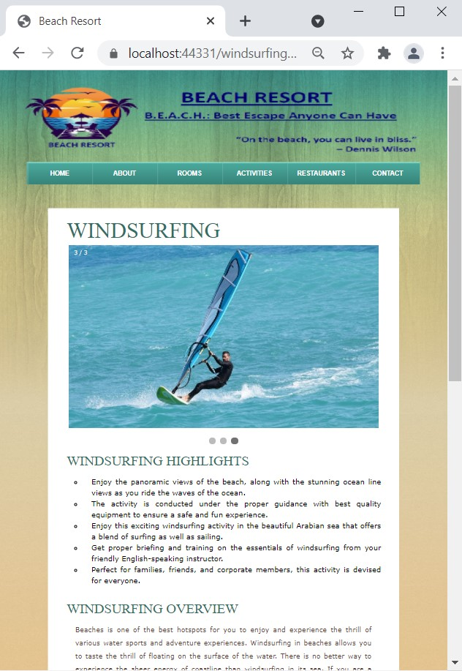
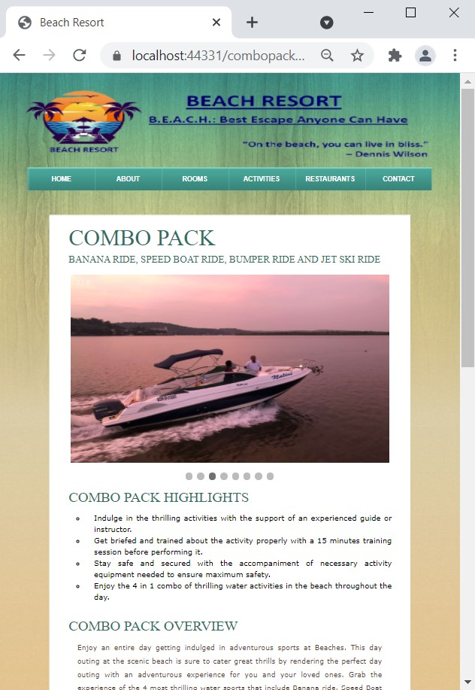
parasailing.aspx
flyboarding.aspx
windsurfing.aspx
combopack.aspx

Slide 35
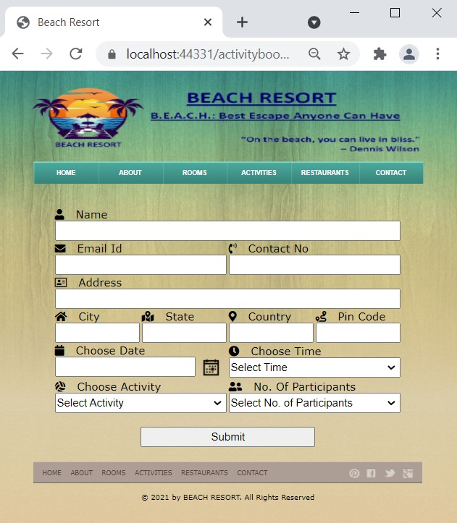
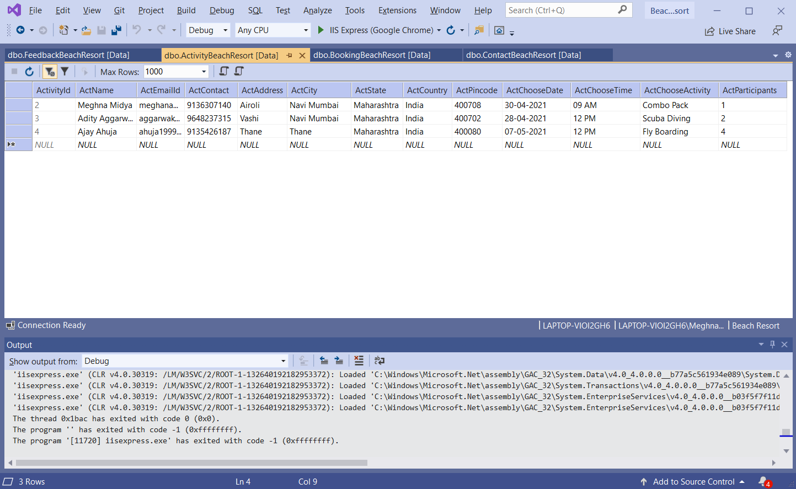
activitybooking.aspx
This is the booking page for activity.

Slide 36
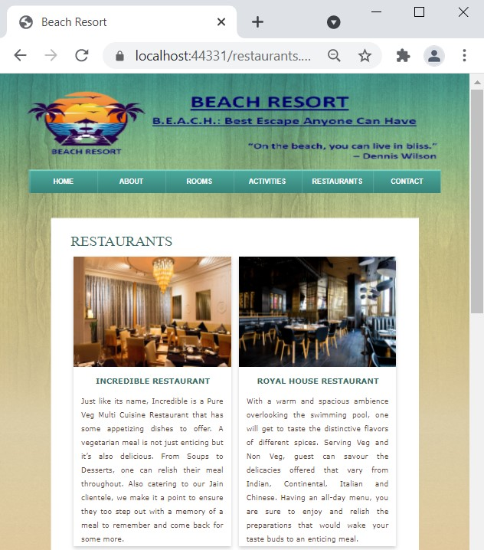
restaurants.aspx
Restaurants page:
This page of the site contain information about restaurants and types of food available in resort. The Beach Resort have a range of options in selecting menu for meal.
Types of restaurants available are:
Incredible Restaurant
Royal House Restaurant
Beach View Restaurant
Ocean Star: The Lounge Bar
Types of cuisines available are:
Indian
Continental
Italian
Chinese

Slide 37
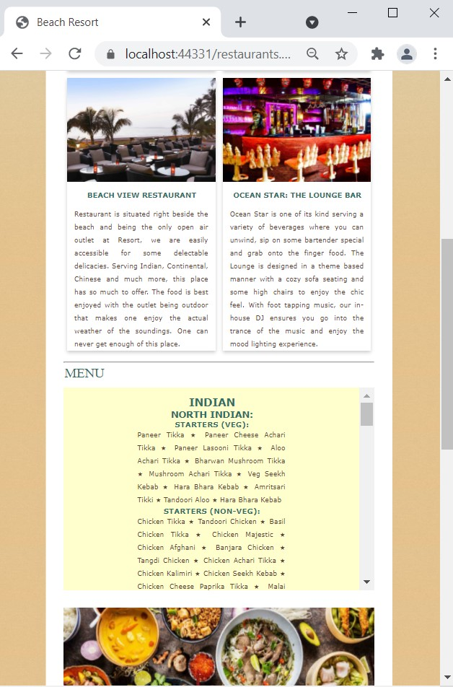
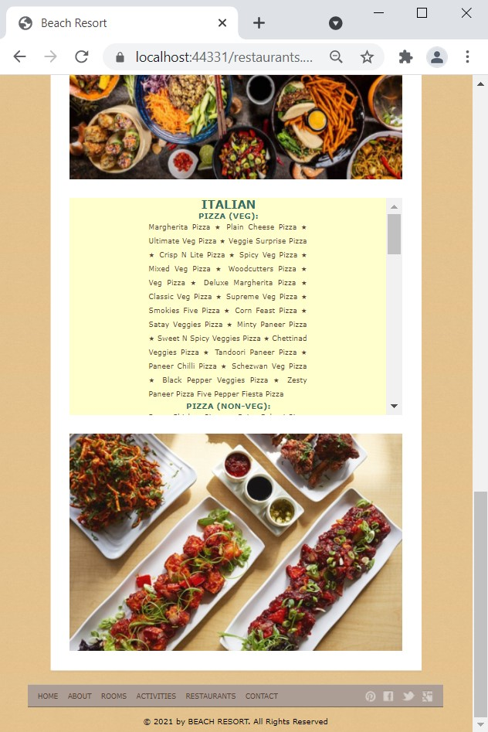

Slide 38
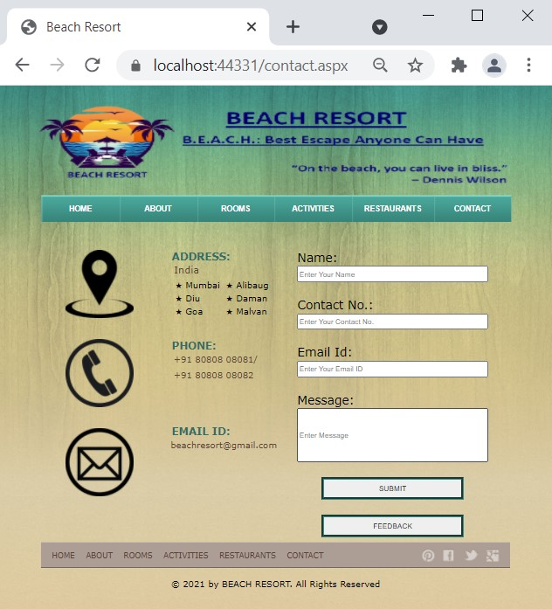
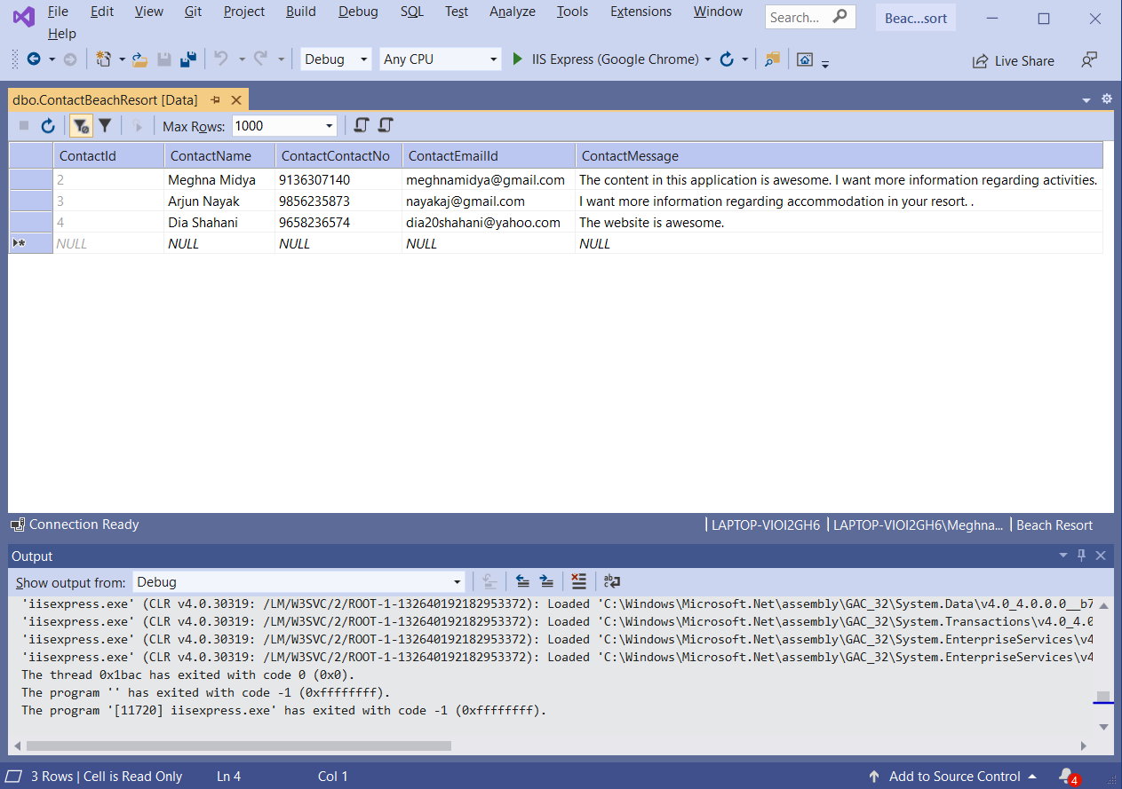
contact.aspx
This is the contact page of the system.

Slide 39
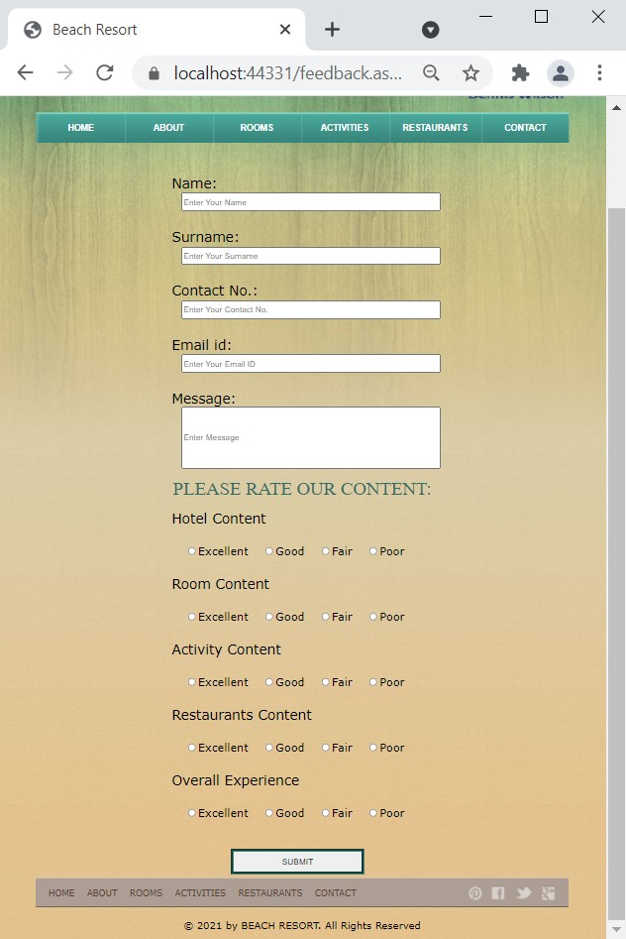
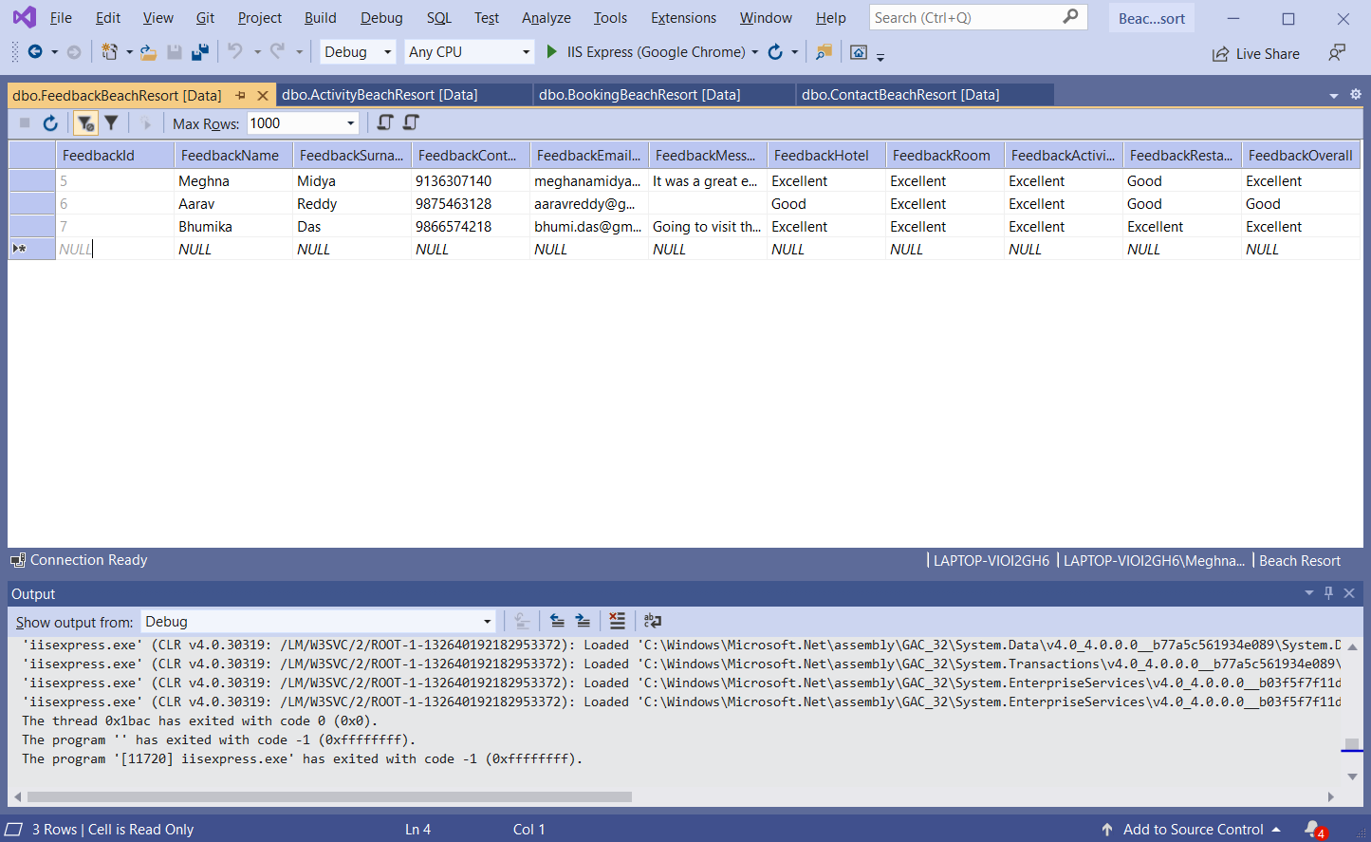
feedback.aspx
This is the feedback page of the system.

Slide 40
CONCLUSION
This project mainly takes care of the resort management at the core area of the database. The system provides information about the various options that are accessible and available in Beach Resort such as accommodation and activities in the beach. The database also maintains the information regarding the different units that are available under one resort and the system also provides compositional details of the unit facilities that are available. Each unit is well provided and is completely planned for the basic adaptability of the visitors who are expected to stay. This project decreases the cost and time of maintaining a book. It is very easy to use and it is very less time consuming.
SCOPE OF FUTURE ENHANCEMENT
No provision is given for doing payment after booking. This process can be added in future development. Developer can add an additional constraint to our project for further enchantment of project without any ambiguity. This project can be further enlarge to provide better flexibility and performance with certain modifications whenever necessary.

Slide 41
REFERENCES
www.google.com
www.w3schools.com
www.youtube.com
www.stackoverflow.com

Slide 42


